Slide 1
Realtime and Big Data Analytics
New York University
Computer Science Department
Graduate School
Fall 2014

Slide 2
Support for Realtime Analytics Class 6
Agenda
Review
NoSQL
Flume
Project Proposals Roundtable
Reference: Twitter API

Slide 3
Support for Realtime Analytics Class 6
Agenda
Review
NoSQL
Flume
Project Proposals Roundtable
Reference: Twitter API

Slide 4
NoSQL Class 6
“NoSQL” refers to “Not Only SQL” databases
“Non-Relational” databases
For storing huge datasets effectively
Reference: http://radar.oreilly.com/2010/06/what-is-data-science.html

Slide 5
NoSQL Class 6
“NoSQL” refers to a range of databases that are not relational databases
Do not support SQL
Do not guarantee ACID properties
Many are descendants of Google’s BigTable and Amazon’s Dynamo
Designed to be distributed across many nodes
Provide “eventual consistency”
Have very flexible schema
Reference: http://radar.oreilly.com/2010/06/what-is-data-science.html

Slide 6
NoSQL Class 6
NoSQL databases
Do not use SQL for data manipulation
Database is optimized for retrieval and append operations
Key–value store – some are built on HDFS
Designed for scalability and performance
Useful for big data in applications where a relational model is not needed
Scale up by adding inexpensive commodity servers
Easier to scale up than with relational databases
Reference: http://radar.oreilly.com/2010/06/what-is-data-science.html

Slide 7
NoSQL Class 6
Examples:
HBase
Part of the Apache Hadoop project
Modeled on Google’s BigTable
Suitable for extremely large databases
Billions of rows, millions of columns
Distributed across thousands of nodes
Cassandra
Developed at Facebook
Used at Twitter, Rackspace, Reddit
High performance, reliable, automatic replication
Very flexible data model
Reference: http://radar.oreilly.com/2010/06/what-is-data-science.html

Slide 8
NoSQL Class 6
NoSQL database systems
Developed to manage large volumes of data that do not necessarily follow a fixed schema
Data is fragmented and stored across many servers
Traditional JOIN operations not supported
Impractical
In HBase, data is sharded across many servers
HBase wants to provide fast response
But in HBase, the capability exists for very, very large rows (millions of columns)
Distributed, fault-tolerant architecture
Useful for managing large amounts of data where satisfying realtime constraints is the priority
Reference: http://radar.oreilly.com/2010/06/what-is-data-science.html

Slide 9
NoSQL Class 6
NoSQL database systems
Good for
Indexing huge amount of documents
Serving pages on high-traffic web sites
Delivering streaming media
Consistency is less important
ACID properties are traded for performance
Reference: http://radar.oreilly.com/2010/06/what-is-data-science.html

Slide 10
NoSQL Class 6
ACID properties guarantee that database transactions are processed reliably
A transaction is a single operation, can be compound
HBase is not an ACID-compliant database¹
What does ACID stand for?
Notes:
Note 1: See http://hbase.apache.org/acid-semantics.html

Slide 11
NoSQL Class 6
ACID:
Atomicity
Consistency
Isolation
Durability

Slide 12
NoSQL Class 6
ACID
Atomicity
Only transactions that have completed successfully are committed to the database
If a part of the transaction fails, the database state must remain unchanged – this may require rolling back partial updates
Consistency
Guarantees that the database state following transaction commitment is valid
Isolation
Concurrently executed transactions have the same result on the state of the database as the execution of those transactions in serial
Transactions are executed independently
Durability
A committed transaction is permanent

Slide 13
NoSQL Class 6
HBase
Built on top of HDFS
HBase provides for random HDFS reads and writes
Writes implemented through versioning of cells
Can define max number of versions to maintain
Can define time-to-live, after that time, the row is automatically pruned by HBase

Slide 14
NoSQL Class 6
HBase Architecture
An HDFS cluster is comprised of master nodes and slave nodes
Similar architecture to
HDFS: Namenode/Datanodes
MapReduce (1.0): Jobtracker, Tasktrackers

Slide 15
NoSQL Class 6
HBase Architecture
An HDFS cluster consists of two types of nodes
One master node
Manages slaves, known as regionservers
Multiple regionserver slave nodes

Slide 16
NoSQL Class 6
HBase Architecture
Master node
Manages a cluster of regionservers
Bootstraps initial install
Assigns regions to registered regionservers
Recovers regionserver failures

Slide 17
NoSQL Class 6
HBase Architecture
Regionservers
Carry zero or more regions
A region is a subset of a table’s rows
Row updates are atomic
Handle read/write requests
Perform region splits, which they communicate to master

Slide 18
NoSQL Class 6
HBase
Distributed column-family-oriented database built on top of HDFS
Good for realtime read/write random access to very large datasets
Easier to expand than a relational database
Partitioning is usually the way to expand
Complex and error-prone
Difficult to maintain
A partitioned RDBMS suffers from feature set that doesn’t scale well
E.g. joins, complex queries, etc.

Slide 19
NoSQL Class 6
HBase
Column Family
Grouping of row columns
Stored together physically
Region
A subset of a table’s rows
Every region belongs to a table

Slide 20
NoSQL Class 6
HBase Regions
Initially, a table is comprised of just one region
As the size of the region grows, it splits
Region splits at a row boundary into two new regions of about equal size
Regions are distributed throughout an HBase cluster
This is how a table can grow very large without the constraints that hamper RDBMS table growth
A table’s total content is the full set of regions

Slide 21
NoSQL Class 6
HBase Features
An operation on a given row is atomic
Locking model is simple
Row keys are sorted, making it easy to locate a particular row via lookup
Sample commands:
create ‘test’ -- creates an HBase table
list -- shows all HBase tabes
put ‘test’, ‘row1’, ‘data:1’, ‘value1’ -- add a row in the data column family
scan ‘test’ -- dumps out all rows
disable ‘test’
drop ‘test’ -- delete table named test

Slide 22
Flume Class 6
Agenda
Review
NoSQL
Flume
Project Proposals Roundtable
Reference: Twitter API

Slide 23
Flume Class 6
Flume is used for data ingest
Apache project
Distributed system for moving large streaming datasets into HDFS
Alternative is to write a custom application to move data into HDFS
For example, one can pipe data being written to a log file into HDFS
Flume nodes can be arranged to form a customized topology
Reference: Hadoop: The Definitive Guide, by Tom White. Chapter 3.

Slide 24
Flume Class 6
A Flume node is configured on those machines that generate the data to be stored into HDFS
A Flume topology can include nodes to aggregate data destined for storage in HDFS, for example
Reference: Hadoop: The Definitive Guide, by Tom White. Chapter 3.

Slide 25
Flume Class 6
The Flume topology consists of
Source nodes
Sink nodes
Channels that link Source and Sink nodes
Flume offers different levels of delivery reliability
Best effort
End-to-End – guaranteed delivery even if multiple Flume nodes fail between the data source and HDFS
Reference: Hadoop: The Definitive Guide, by Tom White. Chapter 3.

Slide 26
Flume Class 6
The Flume Source Node
Consumes events received from an external source
Stores the events into one or more Channels
HDFS
Source
Channel
Sink
Reference: Hadoop: The Definitive Guide, by Tom White. Chapter 3.

Slide 27
Flume Class 6
The Flume Channel
Links Source and Sink nodes
Passive store that buffers the event until it is consumed by a Flume Sink
HDFS
Source
Channel
Sink
Reference: Hadoop: The Definitive Guide, by Tom White. Chapter 3.

Slide 28
Flume Class 6
The Flume Sink
Removes the event from the channel
Puts an event into an external repository, e.g. HDFS
Optionally, forwards an event to the Flume Source of the next Flume agent in the flow
HDFS
Source
Channel
Sink
Source
Reference: Hadoop: The Definitive Guide, by Tom White. Chapter 3.

Slide 29
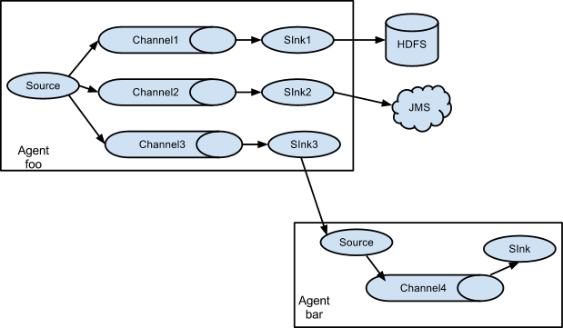
Flume Class 6
Replicating flow to multiple destinations
Two types of fan-out:
1. Replicating Flow - Source from agent “foo” fans out to three different channels
2. Multiplexing Flow - An event is delivered to a subset of available channels when an event’s attribute matches a preconfigured value.
Reference: http://flume.apache.org/FlumeUserGuide.html

Slide 30
Project Proposals Roundtable Class 6
Agenda
Review
NoSQL
Flume
Project Proposals Roundtable
Reference: Twitter API

Slide 31
Project Proposals Roundtable Class 6
Past Project Proposals
Stock market price prediction
Twitter trending/sentiment analysis
Basketball/Football/Soccer game analysis
Earthquake analysis
Others …
Description of each project
High level description
Data source(s)
Technologies being considered
Class feedback
Brainstorming, related ideas worth considering
Data sources
Reference:

Slide 32
Twitter Reference Class 6
Agenda
Review
NoSQL
Flume
Project Proposals Roundtable
Reference: Twitter API

Slide 33
Twitter Reference Class 6
Twitter APIs
Search API
Provides relevant results to ad-hoc user queries from a limited corpus of recent tweets
REST API
Allows access to the nouns and verbs of Twitter
Streaming API
Allows you to stream tweets in real time as they happen
These slides are just for convenience in case you require Twitter for your analytics project. This material will not be on an exam.

Slide 34
Twitter Reference Class 6
Twitter APIs
Search API
Query Twitter content to find
a set of tweets with specific keywords
tweets referencing a specific user
tweets from a particular user
Access data around Trends

Slide 35
Twitter Reference Class 6
Twitter APIs
REST API
Access to some Twitter core primitives
Timelines, status updates, user information
Post tweets back to Twitter
Reply to tweets, retweet, favorite tweets

Slide 36
Twitter Reference Class 6
Twitter APIs
Streaming API
Realtime - Twitter Firehose
For building a data mining product or for analytics research
Specify and track large quantities of keywords
Retrieve geo-tagged tweets from a certain region
Obtain public statuses of a user set

Slide 37
Twitter Reference Class 6
Some analytics projects that have been proposed will require access to tweets.
Here are some useful resources to help you get started:
Here's a link that has instructions for registering, this part is pretty straightforward and allows you to get the keys you would need for OAuth. If you read on, you’ll see a Twitter API example:
http://www.javacodegeeks.com/2011/10/java-twitter-client-with-twitter4j.html
Here are some more links that may help you:
http://twitter4j.org/en/code-examples.html
http://twitter4j.org/en/configuration.html

Slide 38
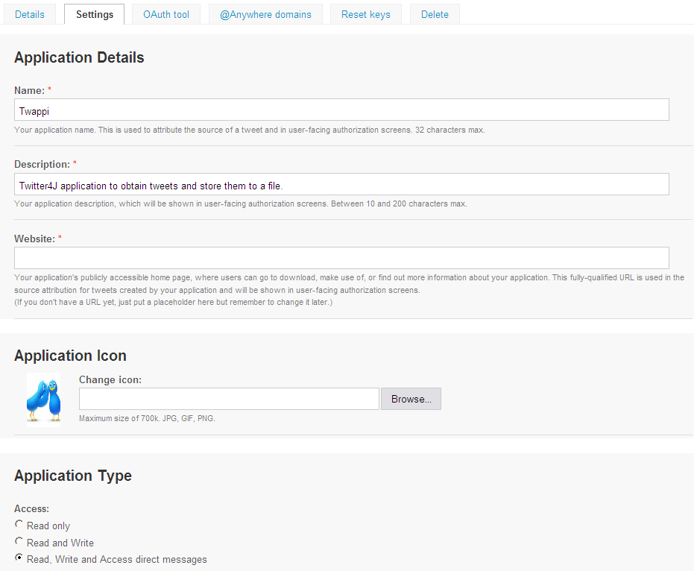
Reference: Twitter API – Application Registration Class 6

Slide 39
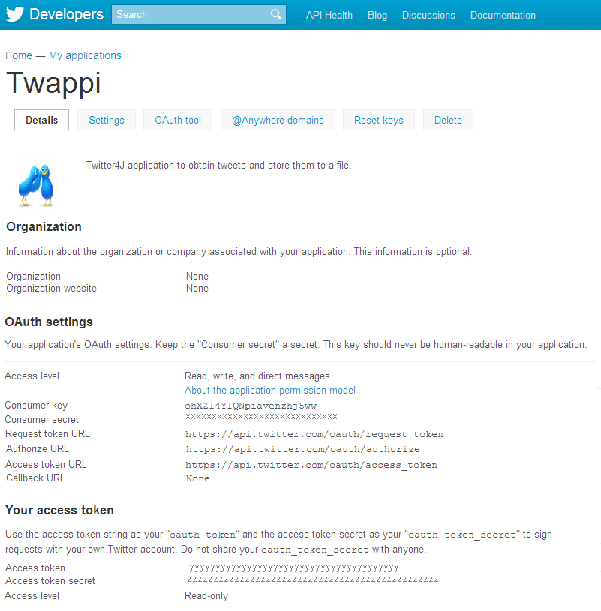
Reference: Twitter API – OAuth Registration Class 6

Slide 40
Reference: Twitter Streaming API Class 6
TwitterStream class
- methods for the streaming API
- create a class that implements StatusListener
- See also twitter4j.examples.stream.PrintSampleStream.java for the detail.
Example1:
public static void main(String[] args) throws TwitterException, IOException{
StatusListener listener = new StatusListener(){
public void onStatus(Status status) {
System.out.println(status.getUser().getName() + " : " + status.getText());
}
public void onDeletionNotice(StatusDeletionNotice statusDeletionNotice) {}
public void onTrackLimitationNotice(int numberOfLimitedStatuses) {}
public void onException(Exception ex) {
ex.printStackTrace();
}
};
TwitterStream twitterStream = new TwitterStreamFactory(listener).getInstance();
// sample() method internally creates a thread which manipulates TwitterStream and
// calls these adequate listener methods continuously.
twitterStream.sample();
}
Reference: Twitter4J website examples

Slide 41
Reference: Twitter Streaming API Class 6
Example2:
package twitter4j.examples.stream;
import twitter4j.*;
public final class PrintSampleStream {
public static void main(String[] args) throws TwitterException {
TwitterStream twitterStream = new TwitterStreamFactory().getInstance();
StatusListener listener = new StatusListener() {
@Override
public void onStatus(Status status) {
System.out.println("@" + status.getUser().getScreenName() + " - " + status.getText());
}
};
twitterStream.addListener(listener);
twitterStream.sample();
}
}
Reference: Twitter4J website examples - Copyright 2007 Yusuke Yamamoto Licensed under the Apache License, Version 2.0 (the "License"); you may not use this file except in compliance with the License. You may obtain a copy of the License at http://www.apache.org/licenses/LICENSE-2.0 Unless required by applicable law or agreed to in writing, software distributed under the License is distributed on an "AS IS" BASIS, WITHOUT WARRANTIES OR CONDITIONS OF ANY KIND, either express or implied. See the License for the specific language governing permissions and limitations under the License.

Slide 42
Homework Class 6
Analytics Project
Refine your project proposal: Add detail to the project description and to the data descriptions to make them more crisp. You should have at least two data sources per project. If there are concerns about this requirement, please email me and we can discuss.
Draw initial diagrams using PowerPoint, Visio, etc. to describe your analytic. Include a diagram of the software architecture (Hadoop components that you’ll use), the data flows, and anything else you think is important to show. This is a first draft, you will refine it in the coming weeks.
Create a list of tasks for your analytics project. Assign team members to tasks, and assign a due date to each task. This can be just a simple table showing tasks, team member name, and date. Try to identify milestones – that will help you know if you are on or off track.
Time to firm up the data sources that you will use in your project. If you are having trouble gaining access to the data, you can send me a note and I will try to contact the owners of the data on your behalf. The other options are to find alternate data, or modify your analytic.
If you are looking for a nice visualization tool for your analytics project, checkout D3 or Processing (both are free)
:
D3: http://d3js.org/
Processing: http://www.processing.org/
Tableau: http://
Nice site with top 20 visualization tools: http://www.netmagazine.com/features/top-20-data-visualisation-tools

